Slide 1


Slide 2
Elevator Pitch

Slide 3
Concept
Notes:
Description
Motivation for development?
User story

Slide 4
Process
Notes:
Technologies used
Breakdown of tasks and roles
Challenges
Successes

Slide 5
Demo
Notes:
Ashley Demos the site
We all touch base and discuss function

Slide 6
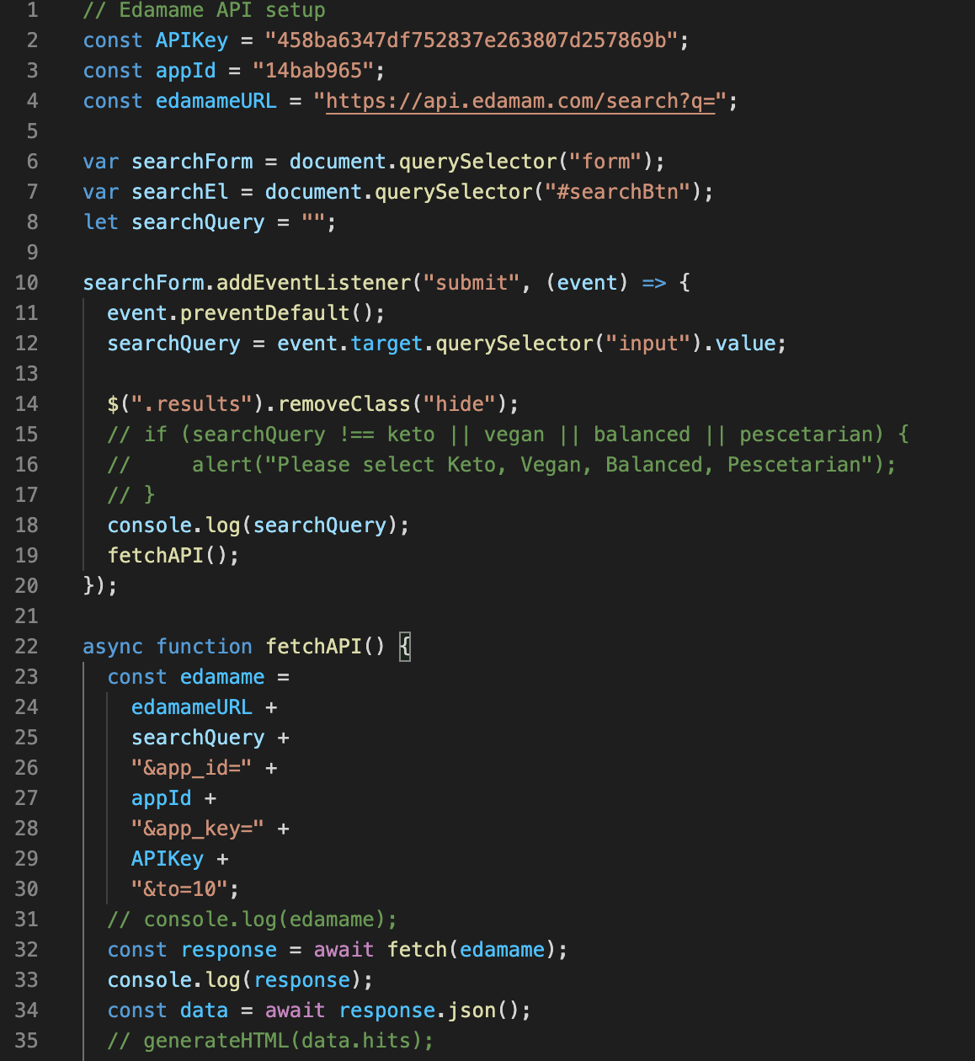
1st API
JS

Slide 7
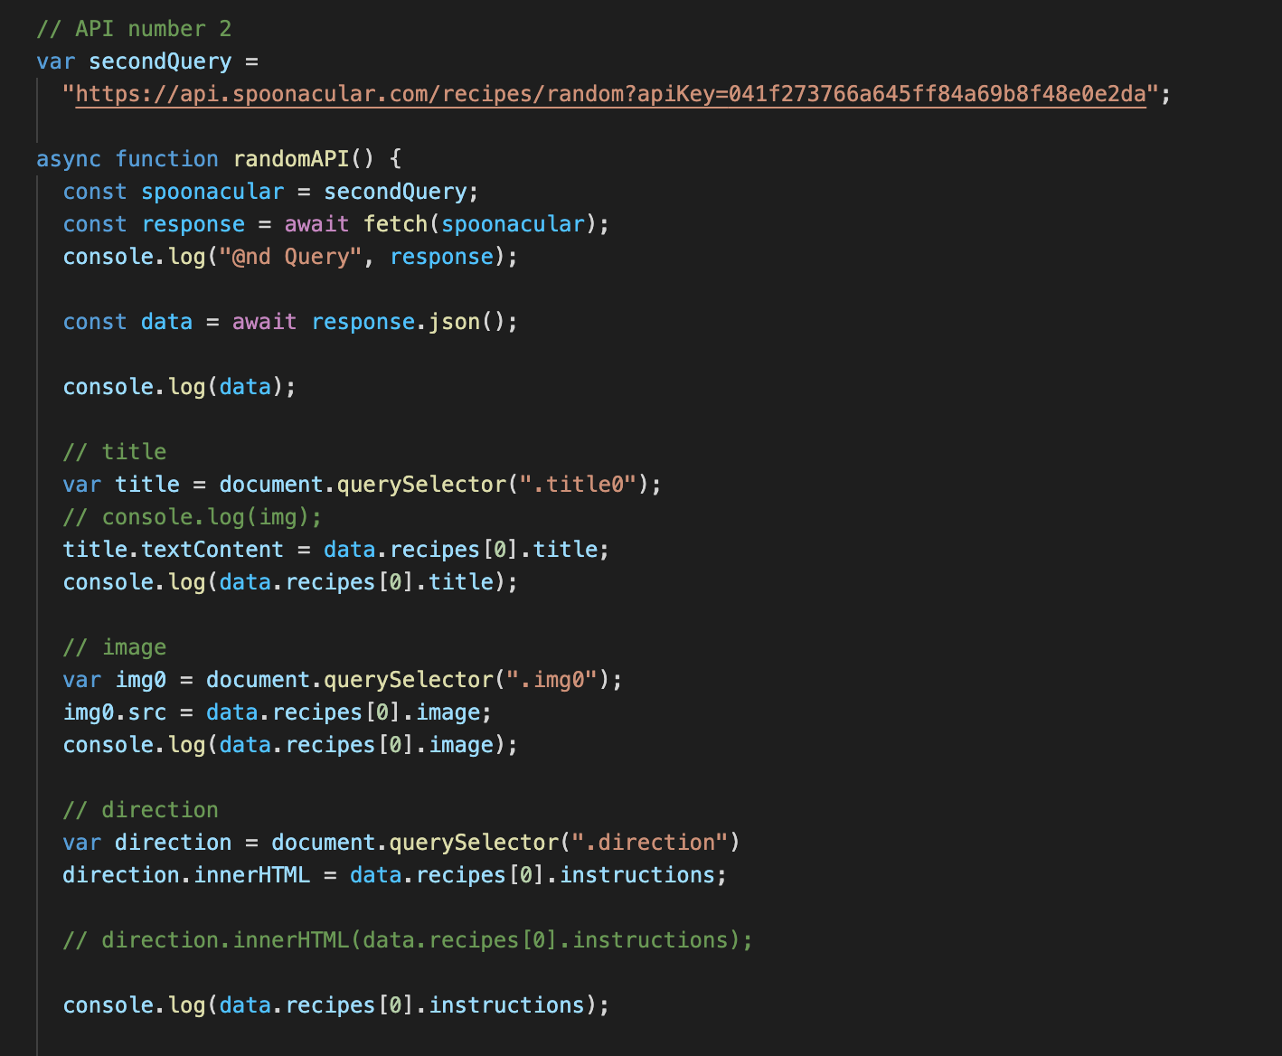
Proudest Parts of Code
2nd API - JS

Slide 8
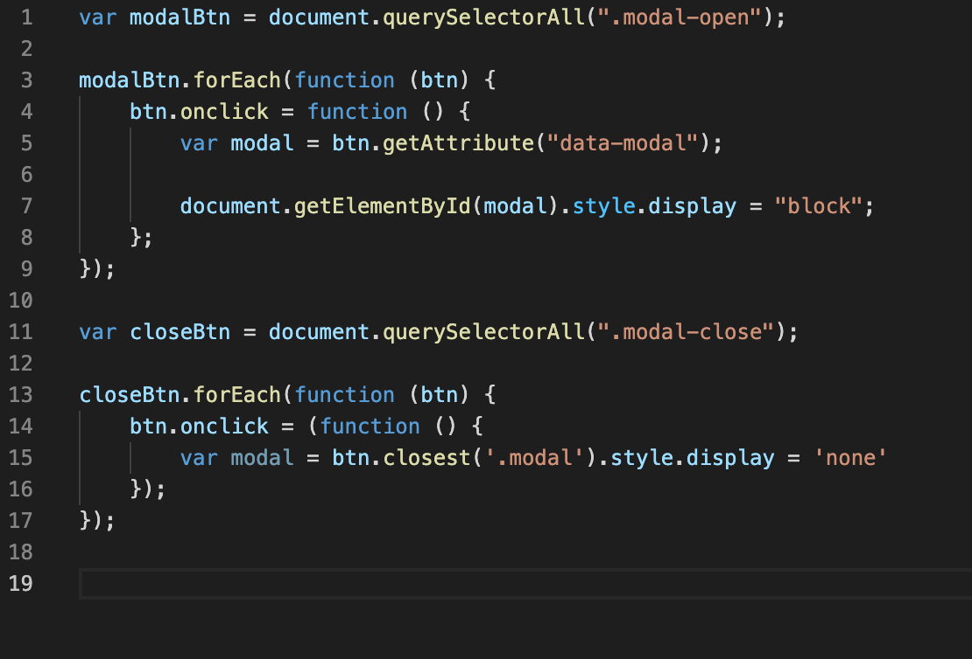
Modal
JS

Slide 9
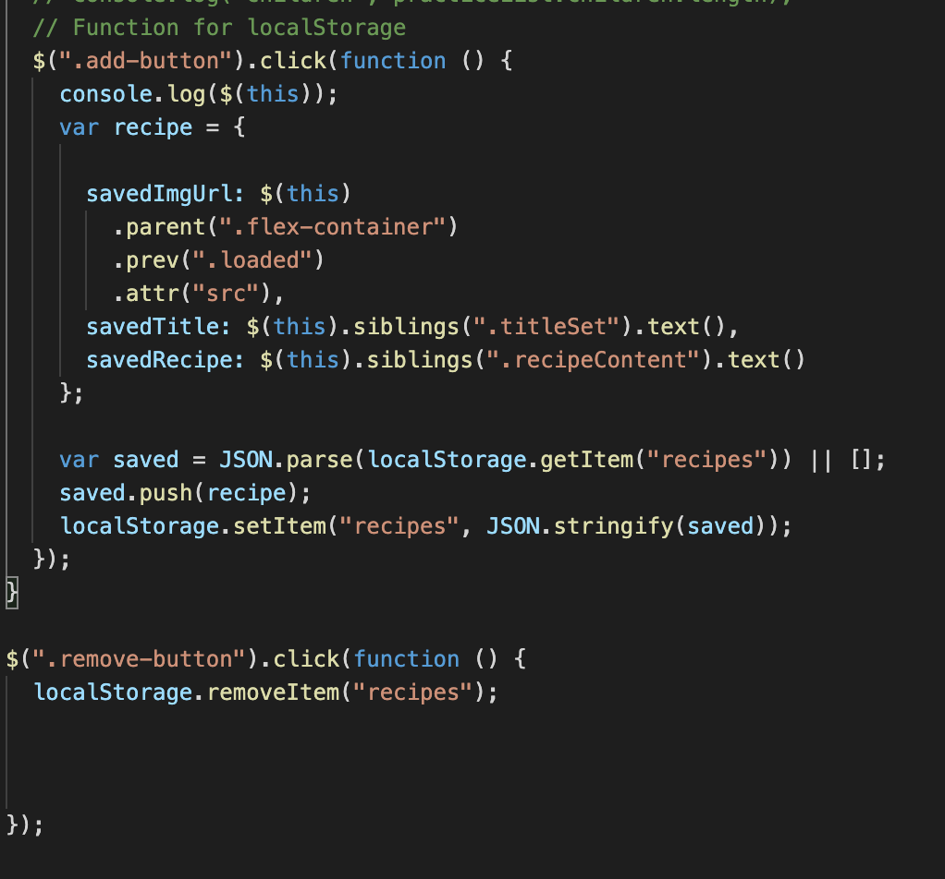
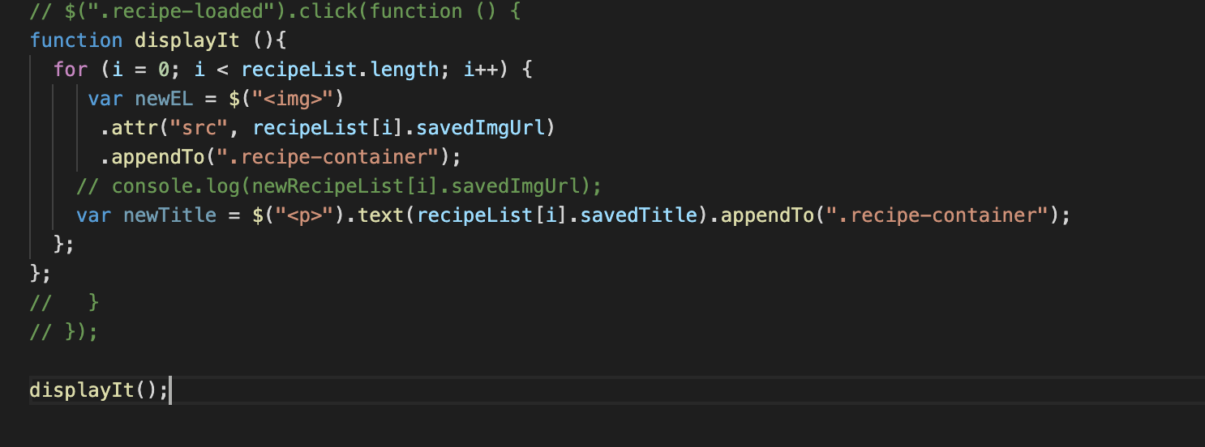
Local Storage and Dynamically displaying html
HTML and JS

Slide 10
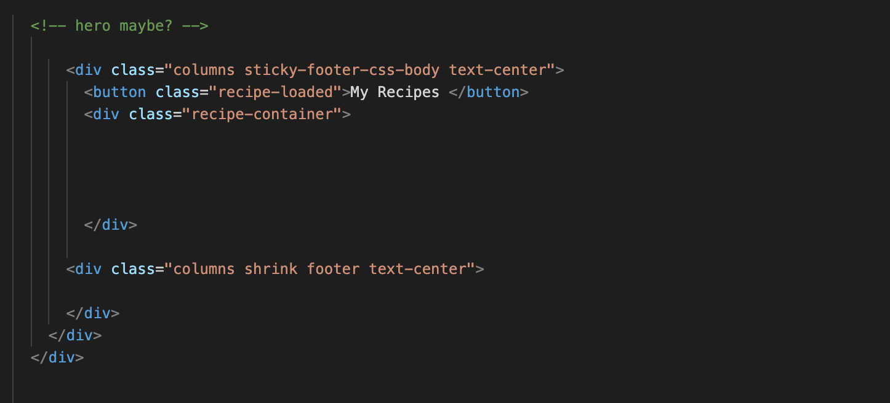
HTML where recipes appended to based on an onClick function

Slide 11
Directions for Future Development
Notes:
Sign-Up/ Log-in page
Modals for the generate recipes
More user friendly / Interactive
Cleaner Layout

Slide 12


Links
Deployed
https://manorathn.github.io/group_5_project_1/
GitHub repo
https://github.com/manorathn/group_5_project_1

